Slide 2
DISINFORMATION
& MISINFORMATION

Slide 3
DISINFORMATION
MEANING
False information deliberately and often covertly spread
(as by the planting of rumors) in order to influence public opinion
or obscure the truth - cause harm.
People spread them to cause harm.

Slide 4
MISINFORMATION
MEANING
False information that’s shared by people who don’t realize it’s false and don’t mean any harm.
They don’t mean to cause harm.

Slide 5
HOW DISINFORMATION IS PROLIFERATED
ABOUT
A software program that can execute commands, reply to messages, or perform routine tasks, as online searches, either automatically or with minimal human intervention.
BOTS
A person who intentionally antagonizes others online by posting inflammatory, irrelevant, or offensive comments or other disruptive content.
TROLL

Slide 6
HOW DOES SOCIAL MEDIA PLAY A CRITICAL ROLE IN SPREADING DISINFORMATION
EASY
NO PREVENTION
INNER CIRCLE
WORLDWIDE
It is easy to share news.
No effective measure to prevent.
The impact of ”inner circle”.
Social Media is effective worldwide.
NO SCIENTIFIC READING
ALGORITHM
FAST
People read posts on social media more than scientific publication
Social media platforms recommend similar news, images and videos based on personal data collection and algorithm.
Faster proliferation of disinformation.

Slide 7
MOST USED SOCIAL MEDIA PLATFORMS
STATISTICS
According to CommEUnication Consortium Survey of November 2021.

Slide 8
LEGAL FRAMEWORK
EU Charter of Fundamental Rights Art. 11
Code of Practice
on Disinformation
“Everyone has the right to freedom of expression. This right shall include freedom to hold opinions and to receive and impart information and ideas without interference by public authority and regardless of frontiers”.
Focuses on:
- disrupting the activities of websites that spread disinformation;
- address the issue of fake accounts and online bots;
facilitating access to different sources of information, improving the visibility of authoritative content, and making it easier to report fake news.

Slide 9
HOW TO TACKLE DISINFORMATION
REPORT FALSE INFORMATION
TO PLATFORMS
GETTING INFORMATION
ON RELIABLE SITES

Slide 10
BECOME A FACT CHECKER
THINK BEFORE YOU SHARE
CHECK THE SOURCE, THE AUTHOR
AND THE PICTURES

Slide 11
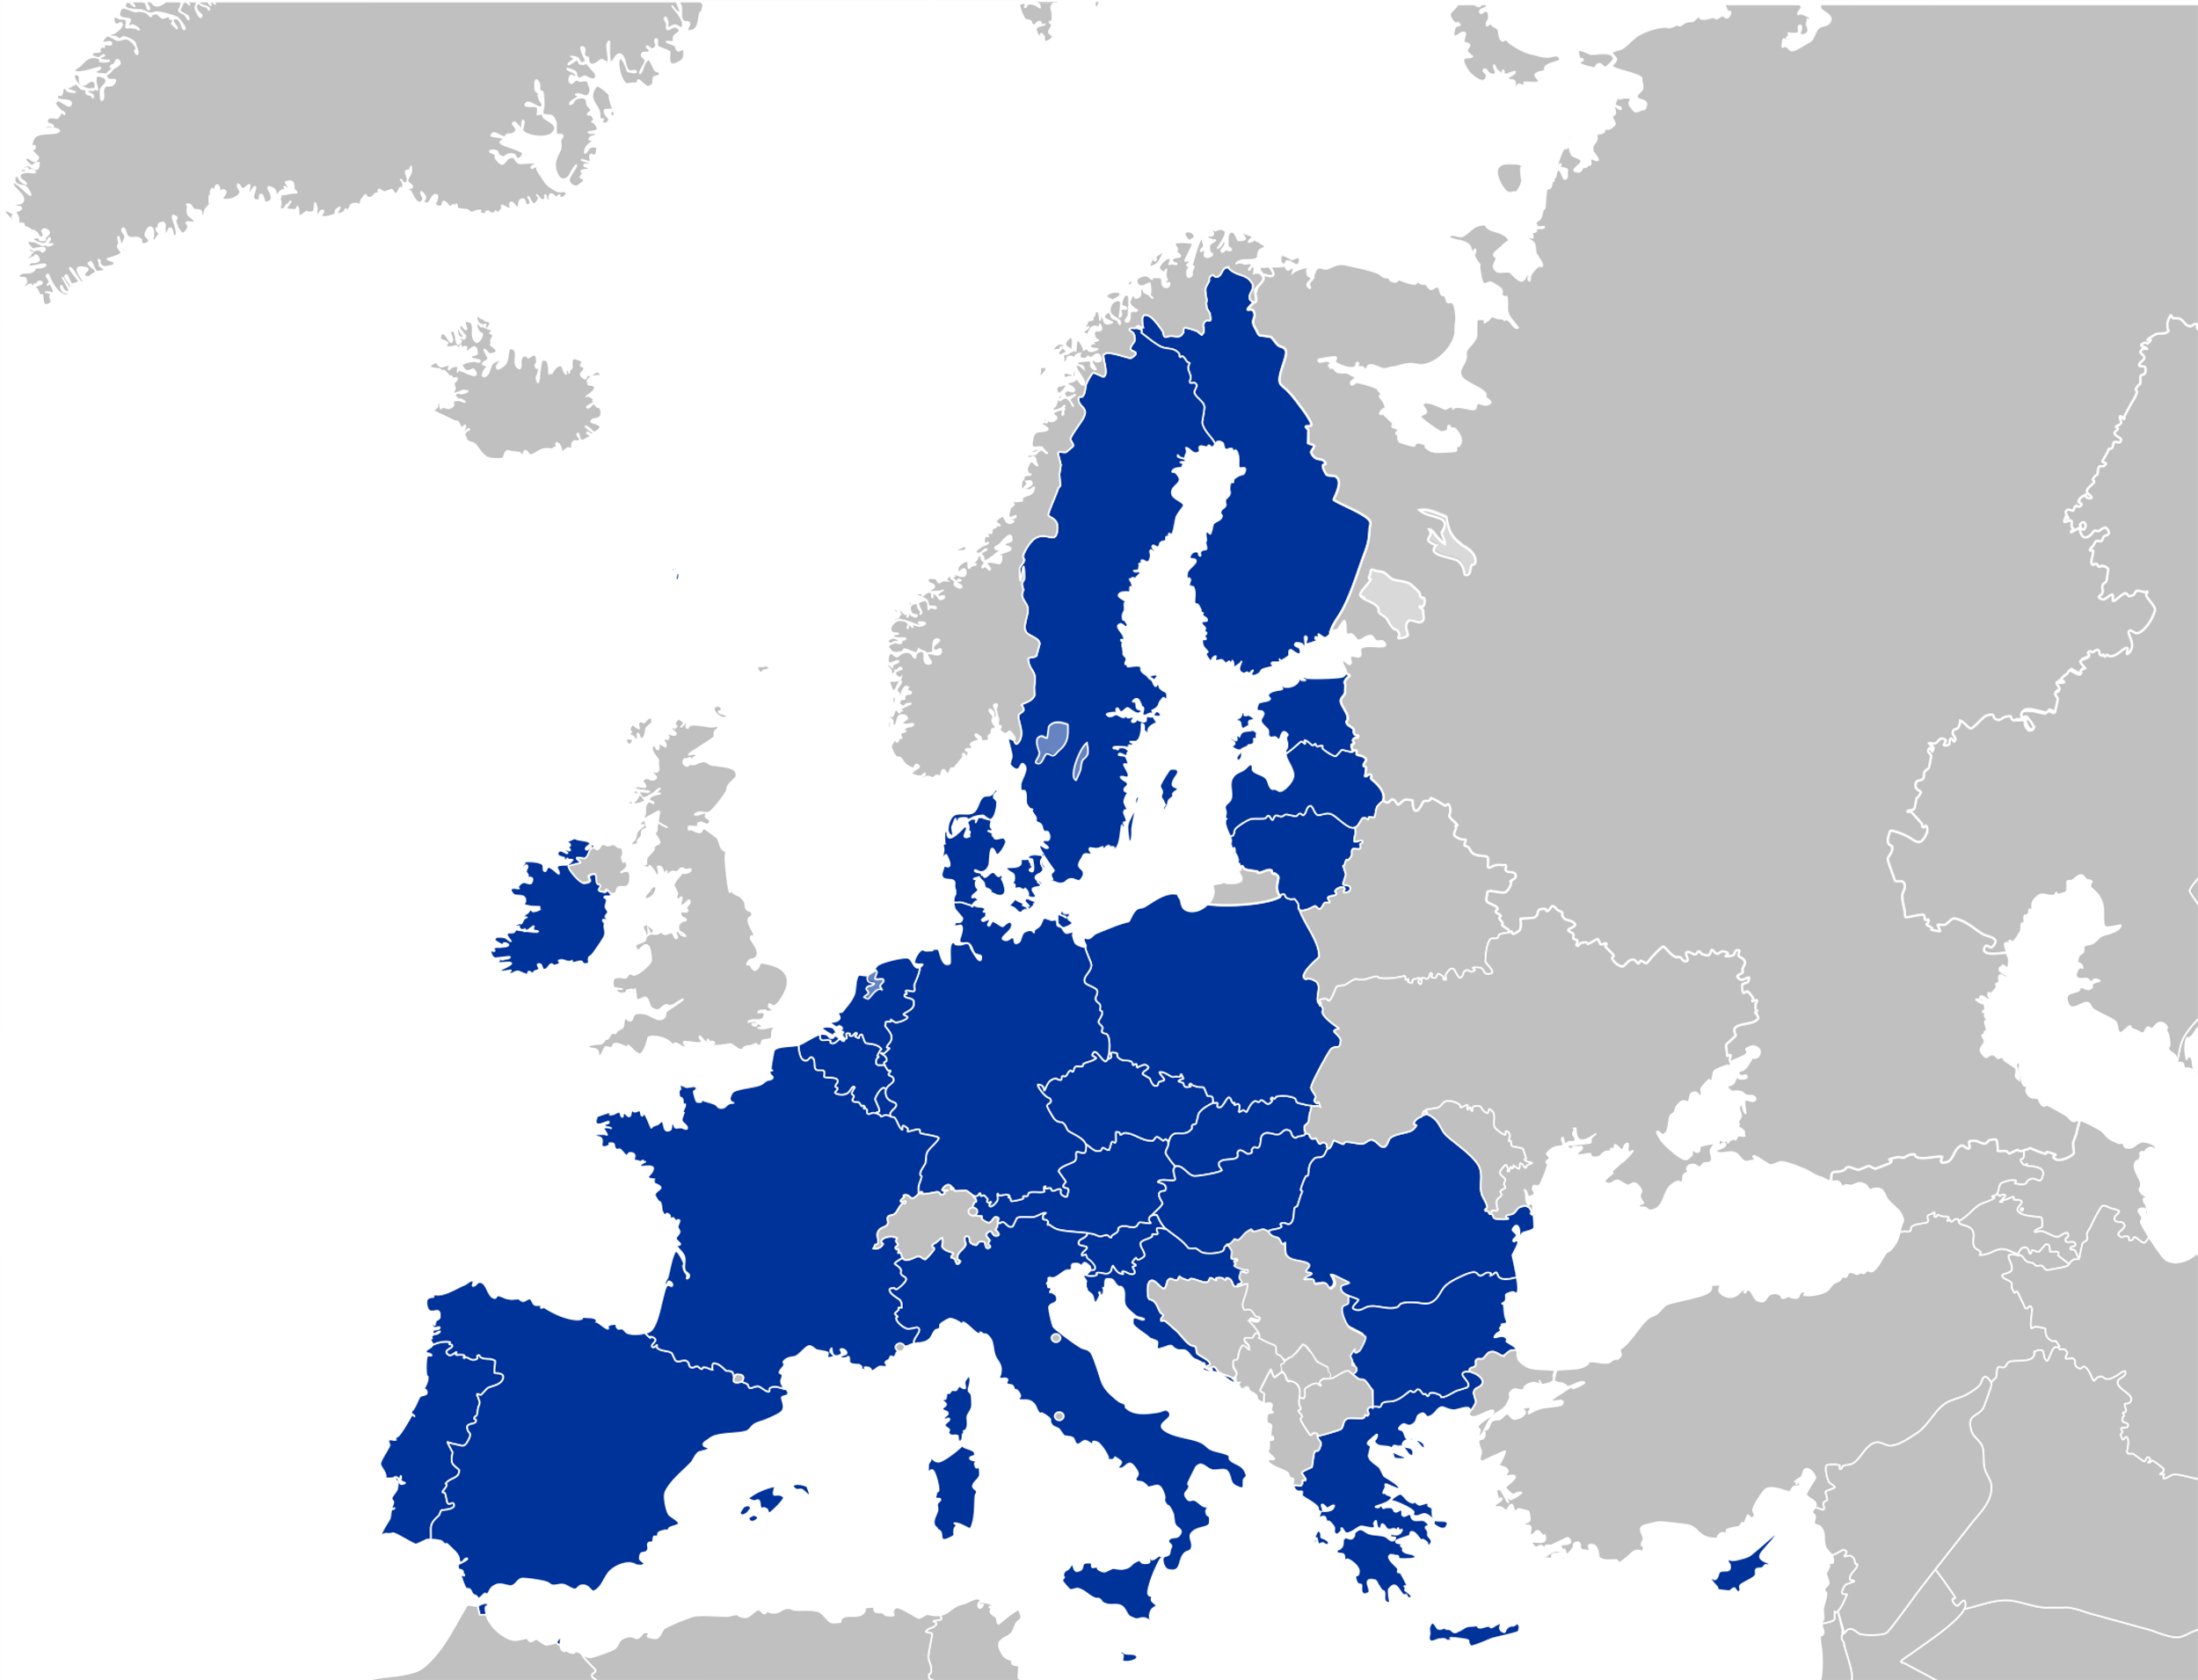
TIPS
EU MEMBER STATES FACT CHECKERS

Slide 12
SOURCE: https://learning-corner.learning.europa.eu/learning-materials/spot-and-fight-disinformation_en
AUSTRIA
Mediamanual
Saferinternet
BUPP
Click & Check
BELGIUM
Mediawijs
BULGARIA
Gramoten
CROATIA
Association for communication and media culture
Children of the media
Media Literacy Days
CYPRUS
Combating Misinformation Through Media Literacy
CZECH REPUBLIC
Clovekvtisni
Fakescape
Elpida
DENMARK
International Media Support
TjekDet
DR Detektor
DR Ultra
Børneavisen
Danske Medier
ESTONIA
Meediapädevuse nädal
SALTO Participation & Information
FINLAND
Media Literacy in Finland
KAVI
Media Literacy School
Mediataitoviikko
Mediakasvastus
YLE Digitrennit
YLE Uutisluokka
FRANCE
IREX Europe
GERMANY
Medienkompetenz stärken
SCHAU HIN! Was Dein Kind mit Medien macht
Gutes Aufwachsen mit Medien
Surfen ohne Risiko
App-Datenbank des Deutschen Jugendinstituts
ACT ON! aktiv + selbstbestimmt online
Kindersuchmaschine "Blinde Kuh“
DW Akademie
GREECE
Media Literacy Institute
Fakescape
HUNGARY
Televele
IRELAND
Be Media Smart
ITALY
Pagella Politica
Facta
Media Education
Eurispes
LATVIA
Pilna doma (Full Thought)
Re:Check
CAPS un CIET jeb vilks manipulators
Medijpratējs
Superheroes in the Internet
LITHUANIA
Draugiškas internetas (Friendly Internet)
Žinau viską
Media literacy platform
Debunk.eu
LUXEMBOURG
Bee-secure
MALTA
BeSmartOnline!
NETHERLANDS
Netwerk Mediawijsheid
European Journalism Centre
Hoezomediawijs
Bad News
SPAIN
Istituto RTVE
Maldita
Internet Segura for Kids
POLAND
Stefan Batory Foundation
Journalistic Craft for Neighborhood
Demagog
Center for Citizenship Education
Nowoczesna Polska
A Kid in the Web
Panoptykon Foundation
Polish Association of Media Literacy
The School with Class Foundation
Wojownicy Klawiatury
Konkret 24
PORTUGAL
MILObs
Internet Segura
National Digital Competence Initiative e.2030
ROMANIA
ActiveWatch
Factual
Funky Citizens
Mediawise Society
SLOVAKIA
Council for Broadcasting and Retransmission
SLOVENIA
NE/JA Razbijalka Mitov
MIPI – medijska in informacijska pismenost
Časoris
Otroci in mediji: iskanje resnice v svetu novic
Medijska pismenost
Safe
SWEDEN
MIK för mig
Swedish International Development Agency
FOJO

Slide 13
REFERENCES
https://fidu.it/language/en/how-much-do-we-know-about-the-eu-results-of-a-european-survey/
https://digital-strategy.ec.europa.eu/en/library/guidance-strengthening-code-practice-disinformation
https://www.politicheeuropee.gov.it/it/comunicazione/notizie/disinformazione-online-codice-di-condotta-per-le-piattaforme-digitali/
https://fra.europa.eu/en/eu-charter/article/11-freedom-expression-and-information
https://digital-strategy.ec.europa.eu/en/library/guidance-strengthening-code-practice-disinformation
https://www.politicheeuropee.gov.it/it/comunicazione/notizie/disinformazione-online-codice-di-condotta-per-le-piattaforme-digitali/
https://www.equalityhumanrights.com/en/human-rights-act/article-10-freedom-expression

Slide 14
STATE
PROPAGANDA

Slide 15
WHAT IS STATE PROPAGANDA
It is a systematic dissemination of information which can be part of a hybrid warfare strategy.
State propaganda is everywhere: in authoritarian AND democratic states, but we do not always recognize it!
It has always existed but today is often more subtle and shared with new tools: social media.
The aim is to create an alternative reality where politicians can get people’s confidence and manipulate thoughts, feelings, and actions.

Slide 16
“
Disinformation, foreign interference, and propaganda can hamper our democratic processes, sowing hatred and fear that costs lives and threaten our own European freedom.
”

Slide 17
European Parliament resolution of March 2022 on foreign interference in all democratic processes in the European Union
Professional media and traditional journalism, as a quality information source, are facing challenging times in the digital era.
Some foreign actors take advantage of Western media freedom to spread disinformation.
The EU supports media freedom through high-quality, sustainably and transparently financed journalism in the digital environment and pluralism; quality journalism education and training within and outside the EU to ensure valuable journalistic analyses and high editorial standards.

Slide 18
4 QUESTIONS TO SPOT STATE PROPAGANDA
ARE THERE MORE THAN ONE PERSPECTIVE?
[OTHERWISE THERE IS A SOURCE BIAS]
WHO RUNS THAT WEBSITE?
[SOURCE SOLIDITY]
DOES IT CREATE HATRED, FEAR, OR PREJUDICES?
[COMMON PROPAGANDA TECHNIQUE:
WHICH IS THE EFFECT OF THESE WORDS?]
When dealing with speeches try to answer some questions.
IS IT A FACT OR AN OPINION?

Slide 19
RISKS AND CONSEQUENCES OF PROPAGANDA
RISKS FOR DEMOCRACY, INFLUENCE ON ELECTIONS AND PEOPLE
INFO
RISKS FOR MEDIA FREEDOM, FREEDOM OF EXPRESSION, AND SOMETIMES EVEN FOR FUNDAMENTAL RIGHTS
PUBLIC OPINION MANIPULATION
OBSCURE OTHER IMPORTANT NATIONAL AND INTERNATIONAL INFORMATION
DIVERTING THE REAL HISTORICAL SOURCES OF AN ISSUE OR TOPIC AND CREATING CONFUSION IN SOCIETY.

Slide 20
WHO IS BEHIND PROPAGANDA
States take control of the media or even create their own social networks and ban free social networks (Russia, China).
Using fake accounts (troll factory) to spread messages on the internet and social networks.
State above all: through official speeches, members of the government, state-controlled or state-financed news agencies, journalists or corrupt media.

Slide 21
HOW TO TACKLE PROPAGANDA
WE HAVE TO MAKE IT SURE
WHETHER IT IS A PROPAGANDA OR NOT.
EDUCATE PEOPLE ABOUT THE ISSUE
Give classes in schools about the issue
Emphasize the importance of non formal education
Organise discussion meetings via workshops with the help of local and national agencies and organisations.
Highlight the importance of pop culture, podcasts and images in the attempt to spread the information in a bigger amount of people

Slide 22
PROMOTE A HIGHER BUDGET TO LOCAL ORGANISATIONS FOR MORE PROJECTS REGARDING THE ISSUE.
NEW NATIONAL STRATEGIES AND A STRONG COMMUNICATION AMONG EU MEMBER STATES REGARDING THE ISSUE.

Slide 23
REFERENCES
https://www.openpolis.it/la-propaganda-social-e-la-difficile-definizione-di-politica/
https://www.ilsole24ore.com/art/perche-non-bisogna-oscurare-falsa-propaganda-nemico-AEFZICKB
https://www.liberties.eu/fr/stories/political-propaganda/43850
https://www.huffingtonpost.it/blog/2022/03/16/news/quando_guardi_in_faccia_il_diavolo-8967181/
https://www.dw.com/en/fact-check-how-do-i-spot-state-sponsored-propaganda/a-60245403
https://www.politico.eu/article/europe-faces-moment-of-reckoning-about-state-media-propaganda/

Slide 24
YOUTH ENGAGEMENT FOR COMMUNICATING THE EU
The project aims at countering euroscepticism through the construction of a new strategy of communication able to promote a correct understanding of the EU, its values and its benefits and at empowering citizens to widen their civic participation and to tackle disinformation. To achieve this, the project will focus on the analysis of the EU general perception in each participating country, and on the promotion of targeted information in those policy areas that represent a priority in the EU agenda, but which are also more susceptible to disinformation, and on the creation of new communication tools able to respond to the needs of the European community.
FIDU and its partners in Belgium, Bulgaria, Greece, Portugal, Ireland and France intend to implement a total of 11 events (both local and international) shaped on the basis of the results of a survey conducted with the aim to get a better and broader understanding of the disinformation phenomenon in the EU and to better respond to the actual needs of European citizens. Upon analysis of such results, local thematic, informative, educational, and interactive trainings addressed to students and young professionals of different backgrounds will be conducted in order to fill the information gaps and to facilitate civil and democratic participation in European policy making. Such trainings are preparatory to the final phase of the project: two creative labs where a selected group of training participants, led by young creative professionals selected on voluntary basis, are asked to shape the ideas developed during the interactive sessions, into new ways of communicating Europe. The final media outputs will be presented to the public during the final event and then distributed through all available channels for a considerable multiplier effect in order to be used from anyone at every level to communicate Europe effectively.

Slide 25
YOUTH ENGAGEMENT FOR COMMUNICATING THE EU
Start Date: 01-04-2021
End Date: 30-09-2022
Participating countries: Italy, Belgium, Bulgaria, Greece, Portugal, Ireland and France
Lead organisation: FIDU – Italian Federation for Human Rights
Partners: European Centre for Economic and Policy Analysis and Affairs, Foundation for Entrepreneurship, Culture and Education, Youth Center of Epirus, Associação Social Recreativa Cultural e Bem Fazer Vai Avante, TASC Europe Studies Company Limited by Guarantee TA/ TASC, Eurasia Net.
Click here to find out the results of our Survey “How much do we know about the EU“
Click here to learn more about our local trainings
Click here to learn more about our creative labs
This project has been funded by the Europe for Citizens Programme of the European Union.
Its contents and materials are the sole responsibility of its authors. The Commission cannot be held responsible for any use which may be made of the information contained therein.

